Slide 1

Synapse Analytics Serverless SQL Pools and Pipelines
The Dream Team

Slide 2
Session
The Lakehouse
Serverless SQL Pools
Demo
Data Lake Partitioning
Synapse Pipelines

Slide 3




Serverless SQL Pools
Azure Storage
Azure Data Lake Gen1 & Gen2
Write
Query external data in Azure Storage, Cosmos DB and Dataverse
SQL Clients
Cosmos DB
Read
Familiar SQL objects
Databases
Stored Procedures
DMVs
Views
External Tables
Serverless SQL Pools
Dataverse
~$5 per 1TB Data Processed (Write/Read)
Serverless SQL Pools are always on, no need to resume/pause/stop
Resources are allocated automatically, no scaling options
It is not a blazing fast interactive database engine

Slide 4

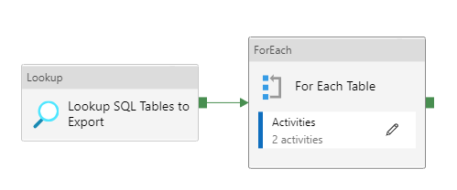
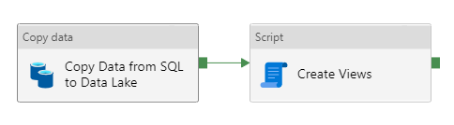
Synapse Pipelines
Azure cloud data movement and transformation service based on Azure Data Factory
We can orchestrate a series of activities that run in sequence
We can load data from a data source into a data destination

Slide 5
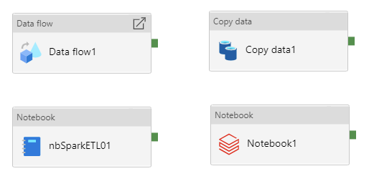
Synapse Pipelines & Serverless SQL Pools
There are multiple ways that Synapse Pipelines can work with Serverless SQL Pools
Mapping Data Flow
Copy Activity
Synapse Notebooks
Databricks Notebook

Slide 6


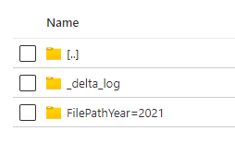

The Lakehouse
Flexiblity of the Data Lake with features available in typical Data Warehouse technology
Transactions
Delta File Format
Supports consistency when writing and reading data
Open-source Storage format
Based on Apache Parquet
Schema Enforcement
Supports batch and streaming data loads
Ensuring schema consistency when writing data
Can INSERT, UPDATE, & DELETE data
Connection Support
Ability to connect various compute engines and tools

Slide 7


Lakehouse Architecture
Serverless SQL Pools can play a part in a Lakehouse architecture to serve data from the Data Lake to Power BI
Data Transformation
Source Data
Serverless SQL Pools
Power BI
Raw
Different formats
Cleansed
Parquet, Delta
Curated
Delta
Data Lake

Slide 8
Data Lake Partitioning
We can use a SQL metadata function filepath() to “partition prune” when querying data in Azure Storage
Delta format does not require this function…we’ll see this in the demo
Data Lake
Serverless SQL Pools View
\EventYear=2022\
\EventMonth=03\
\EventDate=2022-03-01
\EventDate=2022-03-02
\EventDate=2022-03-03
CREATE VIEW…
AS
SELECT filepath(1) AS EventYear,
filepath(2) AS EventMonth,
filepath(3) AS EventDate,
…
SELECT…
…WHERE EventDate = ‘2022-03-02’
EventDate is the 3rd level in the folder hierarchy

Slide 9
Tips for Serverless SQL Pools
Use a small dataset to test with
Use Partitioning in the Data Lake to your advantage
General Serverless SQL Pools Tips
Synapse Analytics, and Azure Storage are in the same region
Use Parquet and Delta file format where possible
Assign the smallest data types possible
File sizes evenly ranged from 100MB to 10GB each

